Slide 1
Image compressıon
Seyma Serttas 1804969
Dr. Lavdie Rada Ulgen

Slide 2
What ıs ımage compressıon?
Image compression refers to the process of reducing the size of an image file while attempting to maintain its visual quality. The purpose of image compression is to minimize the storage space required to store images or to reduce the bandwidth needed for transmitting them over networks. Compression techniques achieve this reduction by removing redundant or irrelevant information from the image data.

Slide 3
Lossless vs. lossy
Lossless | Lossy
Lossless compression algorithms reduce the file size without losing any image data. These algorithms achieve compression by identifying and eliminating redundant information in the image. Examples of lossless compression formats include PNG (Portable Network Graphics) and GIF (Graphics Interchange Format). When a losslessly compressed image is decompressed, it will be identical to the original image. | Lossy compression algorithms achieve higher compression ratios by selectively discarding some image data that may be considered less important to the human visual system. Popular lossy compression formats include JPEG (Joint Photographic Experts Group) and WebP. While lossy compression achieves higher compression ratios, it results in some loss of image quality. When a lossy compressed image is decompressed, there may be a slight degradation in visual quality compared to the original image.

Slide 4

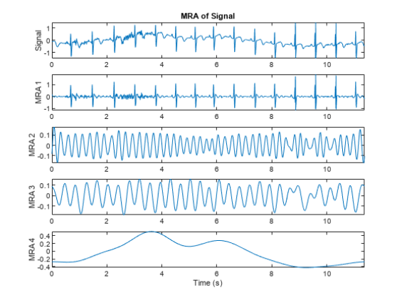
Wavelet transform
Wavelet transform is a mathematical technique that breaks down signals or images into smaller components called wavelets. These wavelets capture different frequency components and allow for analyzing signals at different scales. The transform provides a multiresolution representation, capturing both global and local characteristics of the signal or image.

Slide 5
Wavelet-based ımage compressıon
Wavelet-based image compression is a technique that uses wavelet transforms to decompose an image into different frequency bands. The low-frequency components represent the coarse structure, while the high-frequency components capture fine details. By discarding or quantizing the less important high-frequency components, the image can be compressed. The compressed data is then encoded and can be reconstructed by applying inverse wavelet transforms.

Slide 6
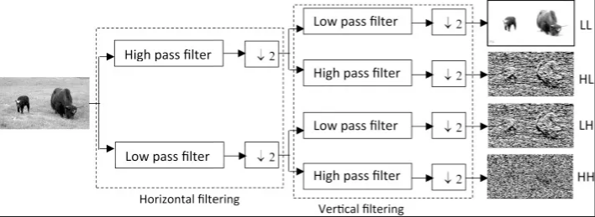
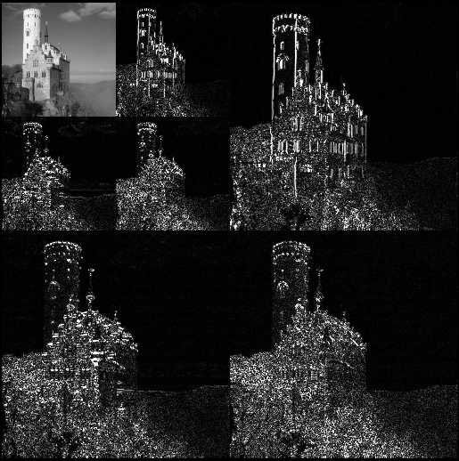
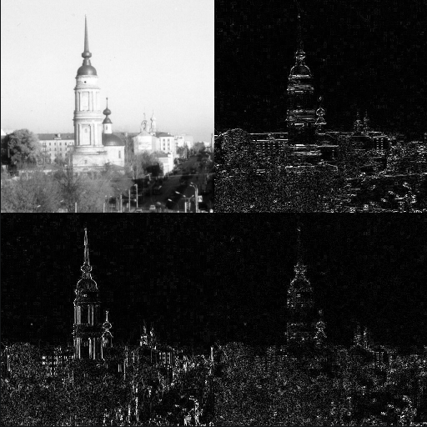

Slide 7
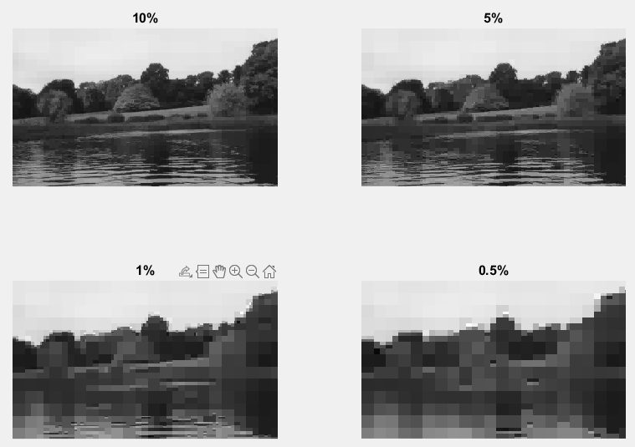
Importance of thresholding

Slide 8
References
Parida et al. , 2017. Wavelet based transition region extraction for image segmentation. Future Computing and Informatics Journal.
https://www.mathworks.com/help/wavelet/ref/ewt.html
https://en.wikipedia.org/wiki/Wavelet_transform
A. Al Jumah, “Denoising of an Image Using Discrete Stationary Wavelet Transform and Various Thresholding Techniques,” Journal of Signal and Information Processing, Vol. 4 No1, 2013, pp. 33–41. doi: 10.4236/jsip.2013.41004
https://en.wikipedia.org/wiki/Image_compression

